Slide 1
Internet路由协议

Slide 2
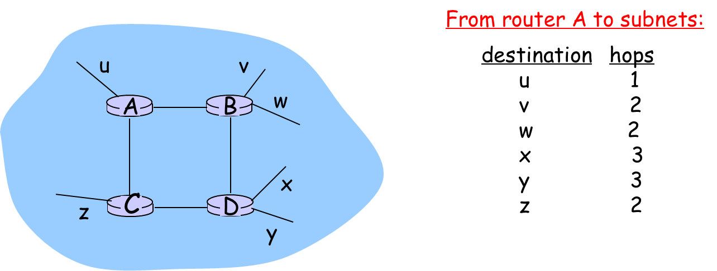
RIP ( Routing Information Protocol)
distance vector algorithm
included in BSD-UNIX Distribution in 1982
distance metric: # of hops (max = 15 hops)

Slide 3
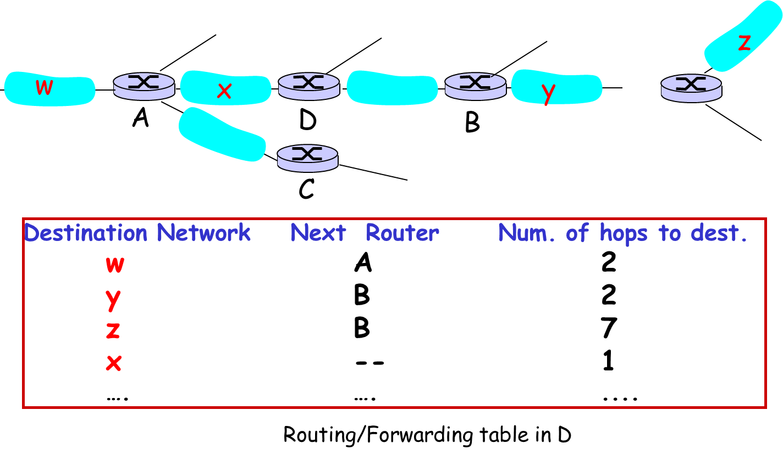
RIP: Example

Slide 4
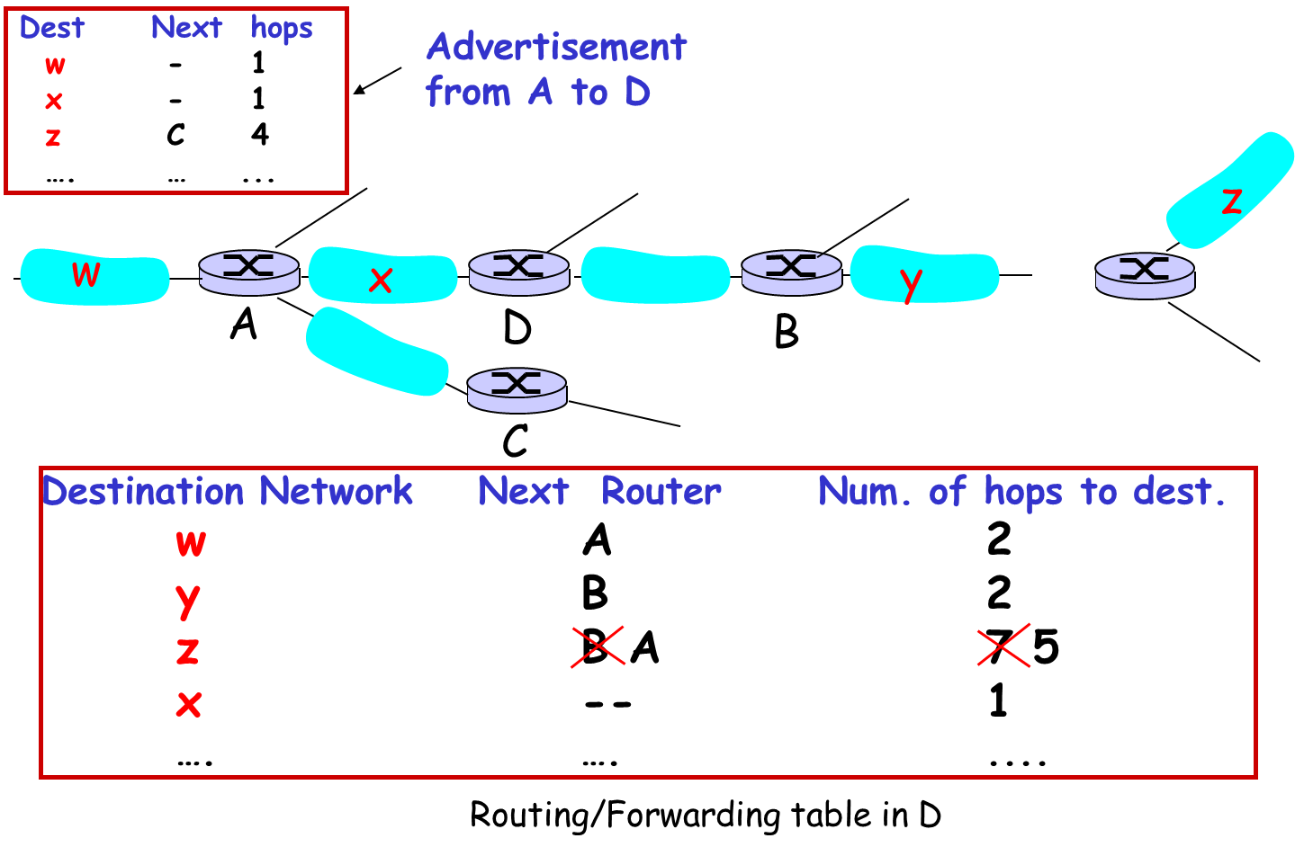
RIP: Example

Slide 5
RIP advertisements
distance vectors: exchanged among neighbors every 30 sec via Response Message (also called advertisement)
each advertisement: list of up to 25 destination subnets within AS

Slide 6
RIP: Link Failure and Recovery
If no advertisement heard after 180 sec --> neighbor/link declared dead
routes via neighbor invalidated
new advertisements sent to neighbors
neighbors in turn send out new advertisements (if tables changed)
link failure info quickly (?) propagates to entire net
poison reverse used to prevent ping-pong loops (infinite distance = 16 hops)

Slide 7
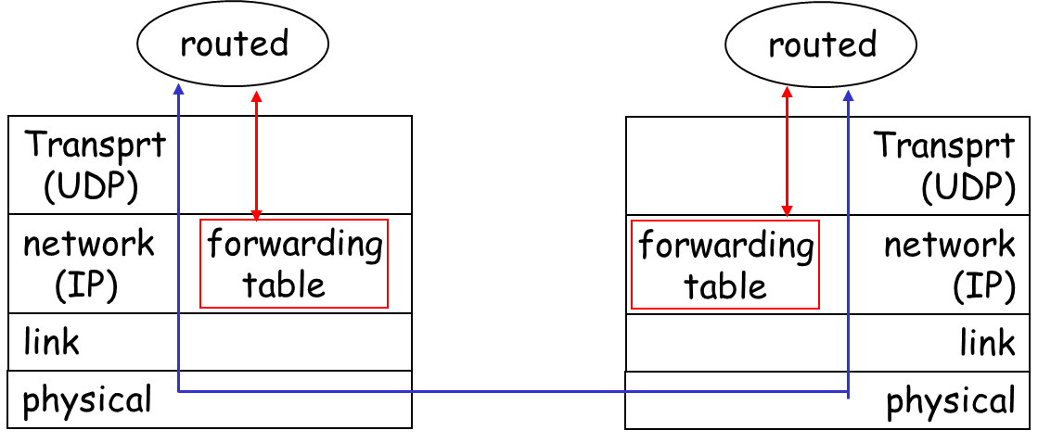
RIP Table processing
RIP routing tables managed by application-level process called route-d (daemon)
advertisements sent in UDP packets, periodically repeated

Slide 8
OSPF (Open Shortest Path First)
“open”: publicly available
uses Link State algorithm
LS packet dissemination
topology map at each node
route computation using Dijkstra’s algorithm
OSPF advertisement carries one entry per neighbor router
advertisements disseminated to entire AS (via flooding)
carried in OSPF messages directly over IP (rather than TCP or UDP

Slide 9
OSPF “advanced” features (not in RIP)
security: all OSPF messages authenticated (to prevent malicious intrusion)
multiple same-cost paths allowed (only one path in RIP)
For each link, multiple cost metrics for different TOS (e.g., satellite link cost set “low” for best effort; high for real time)
integrated uni- and multicast support:
Multicast OSPF (MOSPF) uses same topology data base as OSPF
hierarchical OSPF in large domains.

Slide 10
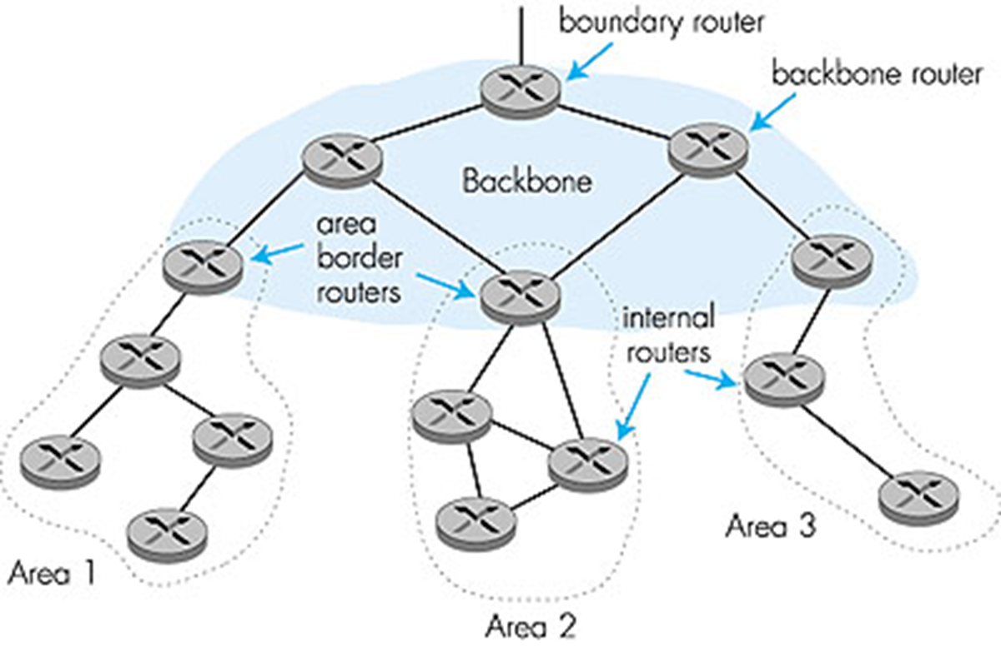
Hierarchical OSPF

Slide 11
Hierarchical OSPF
two-level hierarchy: local area, backbone.
Link-state advertisements only in area
each nodes has detailed area topology; only know direction (shortest path) to nets in other areas.
area border routers: “summarize” distances to nets in own area, advertise to other Area Border routers.
backbone routers: run OSPF routing limited to backbone.
boundary routers: connect to other AS’s.

Slide 12
Internet inter-AS routing: BGP
BGP (Border Gateway Protocol): the de facto standard
BGP provides each AS a means to:
Obtain subnet reachability information from neighboring ASs.
Propagate reachability information to all AS-internal routers.
Determine “good” routes to subnets based on reachability information and policy.
allows subnet to advertise its existence to rest of Internet: “I am here”

Slide 13
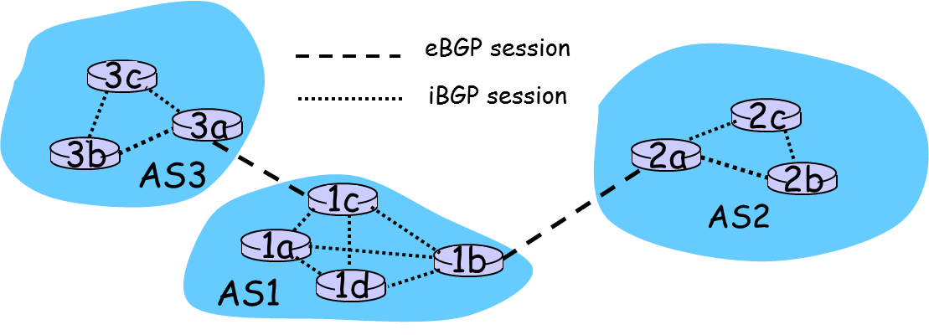
BGP basics
pairs of routers (BGP peers) exchange routing info over semi-permanent TCP connections: BGP sessions
BGP sessions need not correspond to physical links.
when AS2 advertises a prefix to AS1:
AS2 promises it will forward datagrams towards that prefix.
AS2 can aggregate prefixes in its advertisement

Slide 14
Distributing reachability info
using eBGP session between 3a and 1c, AS3 sends prefix reachability info to AS1.
1c can then use iBGP do distribute new prefix info to all routers in AS1
1b can then re-advertise new reachability info to AS2 over 1b-to-2a eBGP session
when router learns of new prefix, it creates entry for prefix in its forwarding table.

Slide 15
Why different Intra- and Inter-AS routing ?
Policy:
Inter-AS: admin wants control over how its traffic routed, who routes through its net.
Intra-AS: single admin, so no policy decisions needed
Scale:
hierarchical routing saves table size, reduced update traffic
Performance:
Intra-AS: can focus on performance
Inter-AS: policy may dominate over performance

Slide 16

Summary
RIP
OSPF
BGP

